Slide 1
Pizza Ordering App Usability Study 07-Aug-2022 Creator : Akshit G

Slide 2

Study Details

Slide 3

Project Status
Phase 1
Phase 2
Phase 3
Research, Wireframes,
Low-fidelity Product Testing
Revised Wireframes From User Feedback, Plans For Additional Research
Final Design, High-Fidelity Prototype Testing

Slide 4
Feedback
Login Page
Ordering
Payment
Users would like an option to skip the login.
Some also need more login options
Users would like an option to add items to a favourite list for quick ordering
Users would like more payment methods and default options

Slide 5
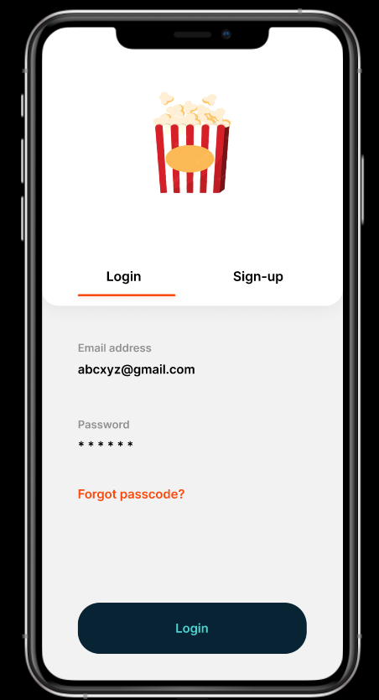
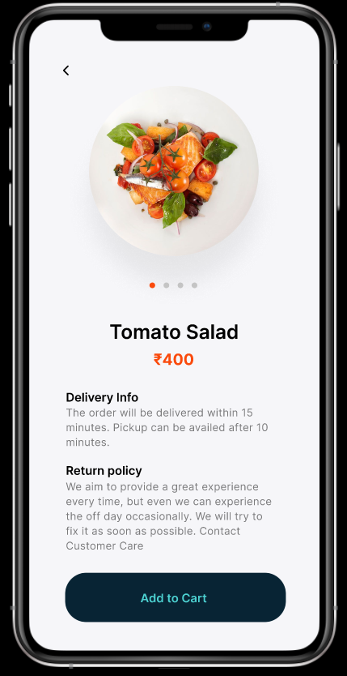
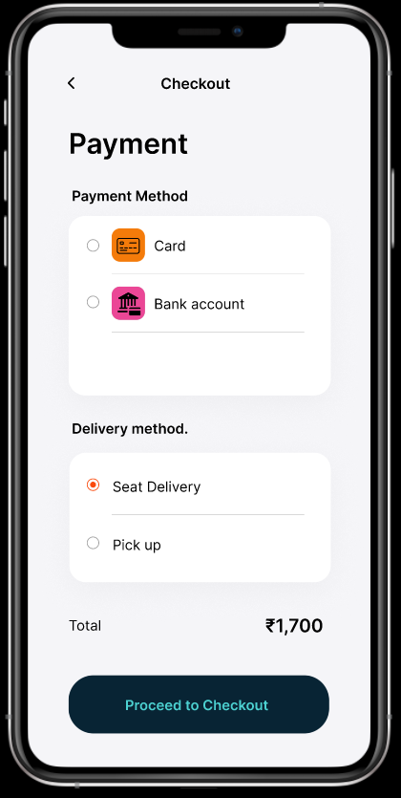
Initial Prototype

Slide 6
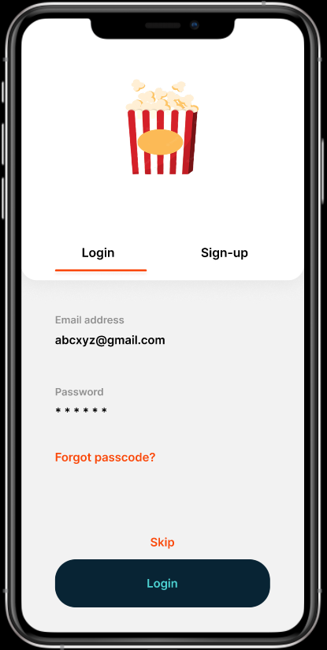
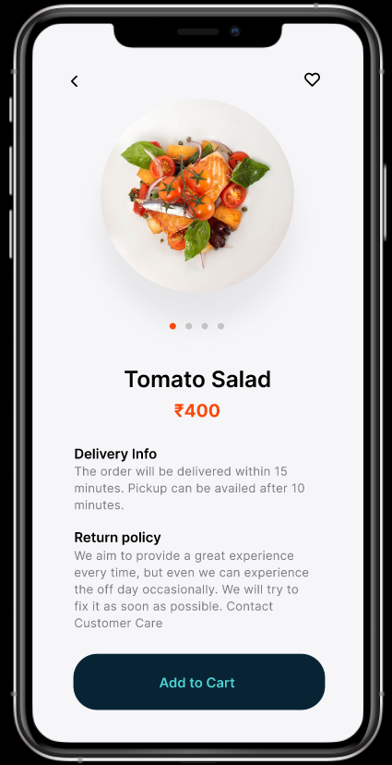
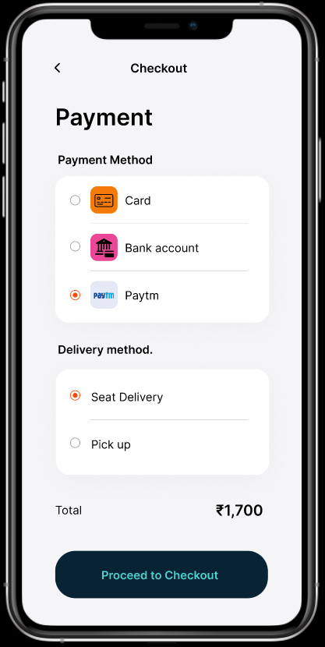
Revised Prototype

Slide 7
Recommendations
Users should use the chat option for instant customer care
More menu items can make the app look clumsy
App can be more colourful

Slide 8
What’s Next
High-Fidelity Prototype
More options for payment
Options to share order confirmation

Slide 9
Thank You !

